Slide 1




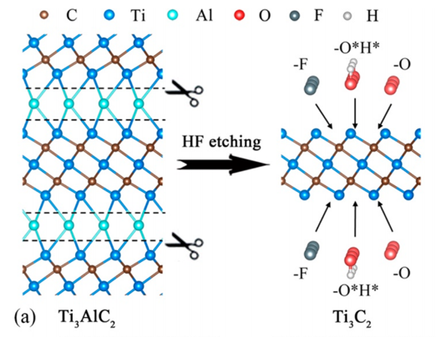
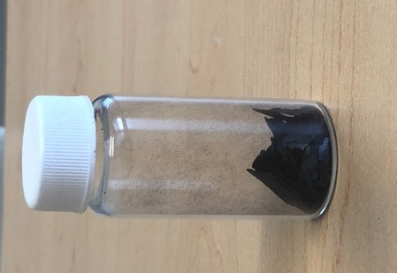
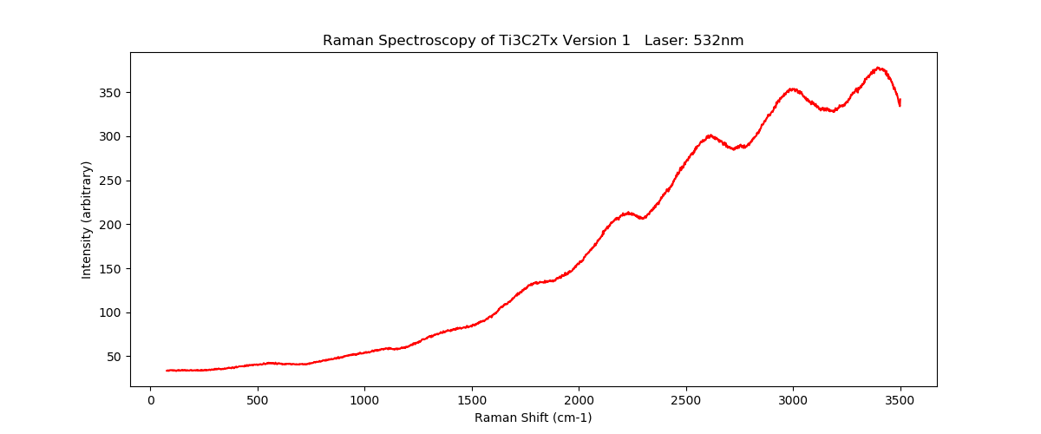
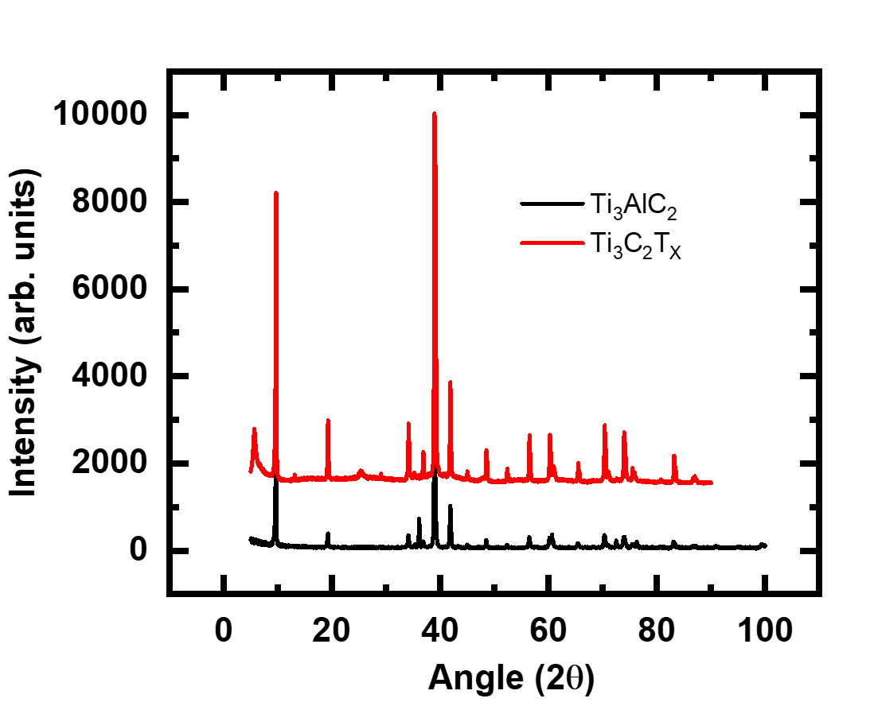
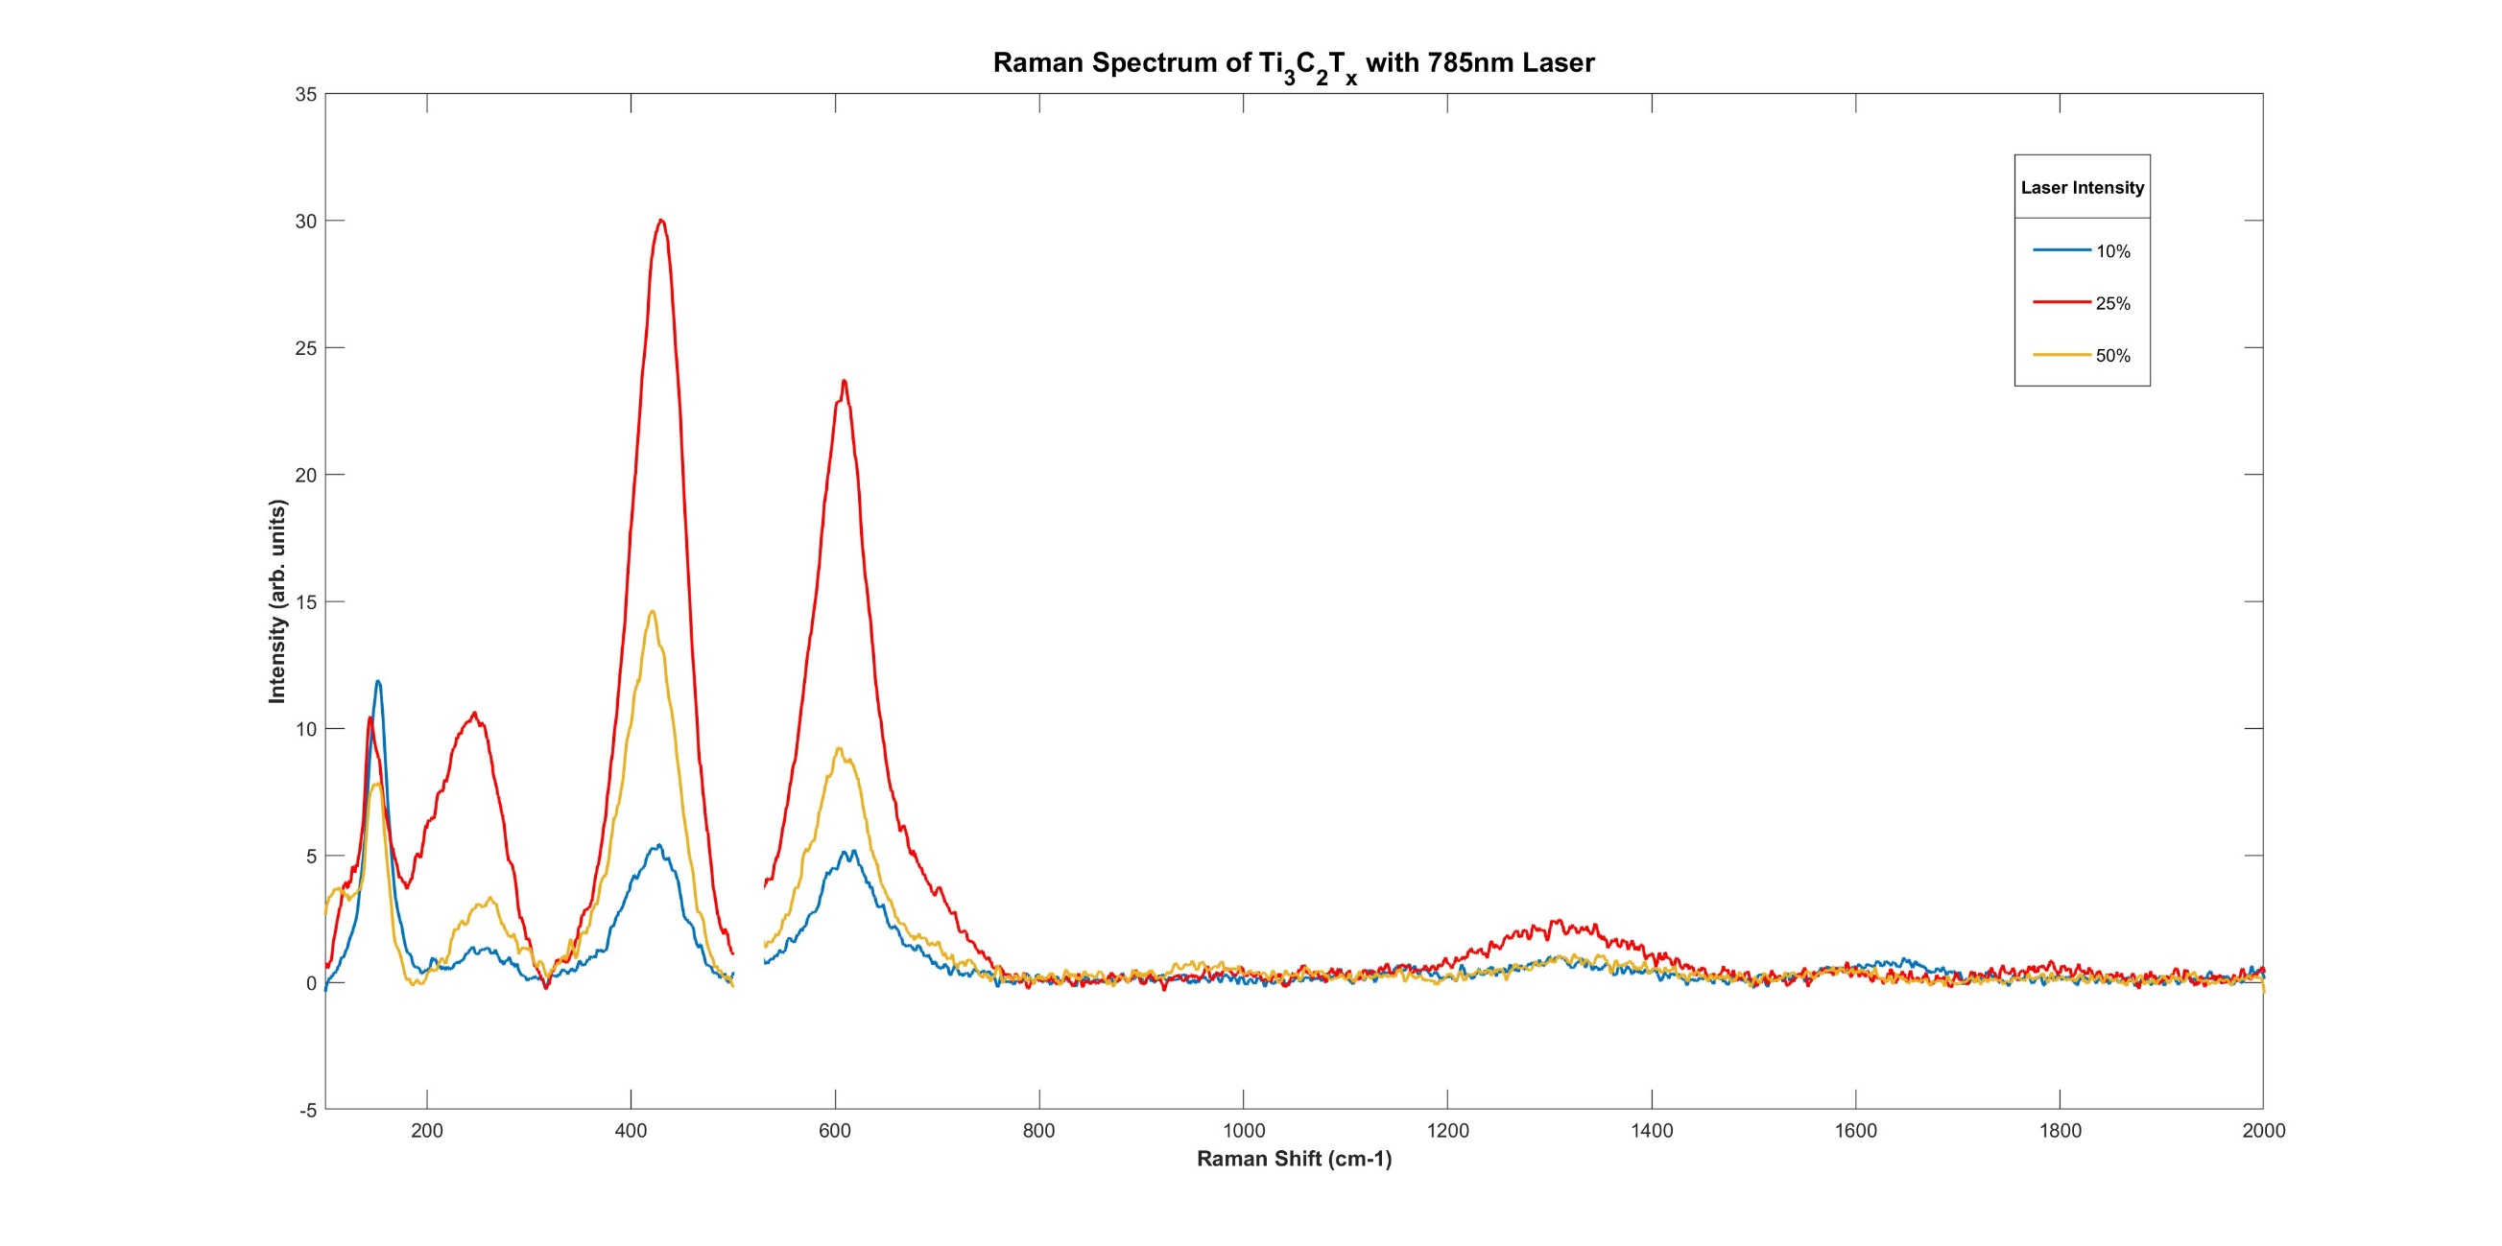
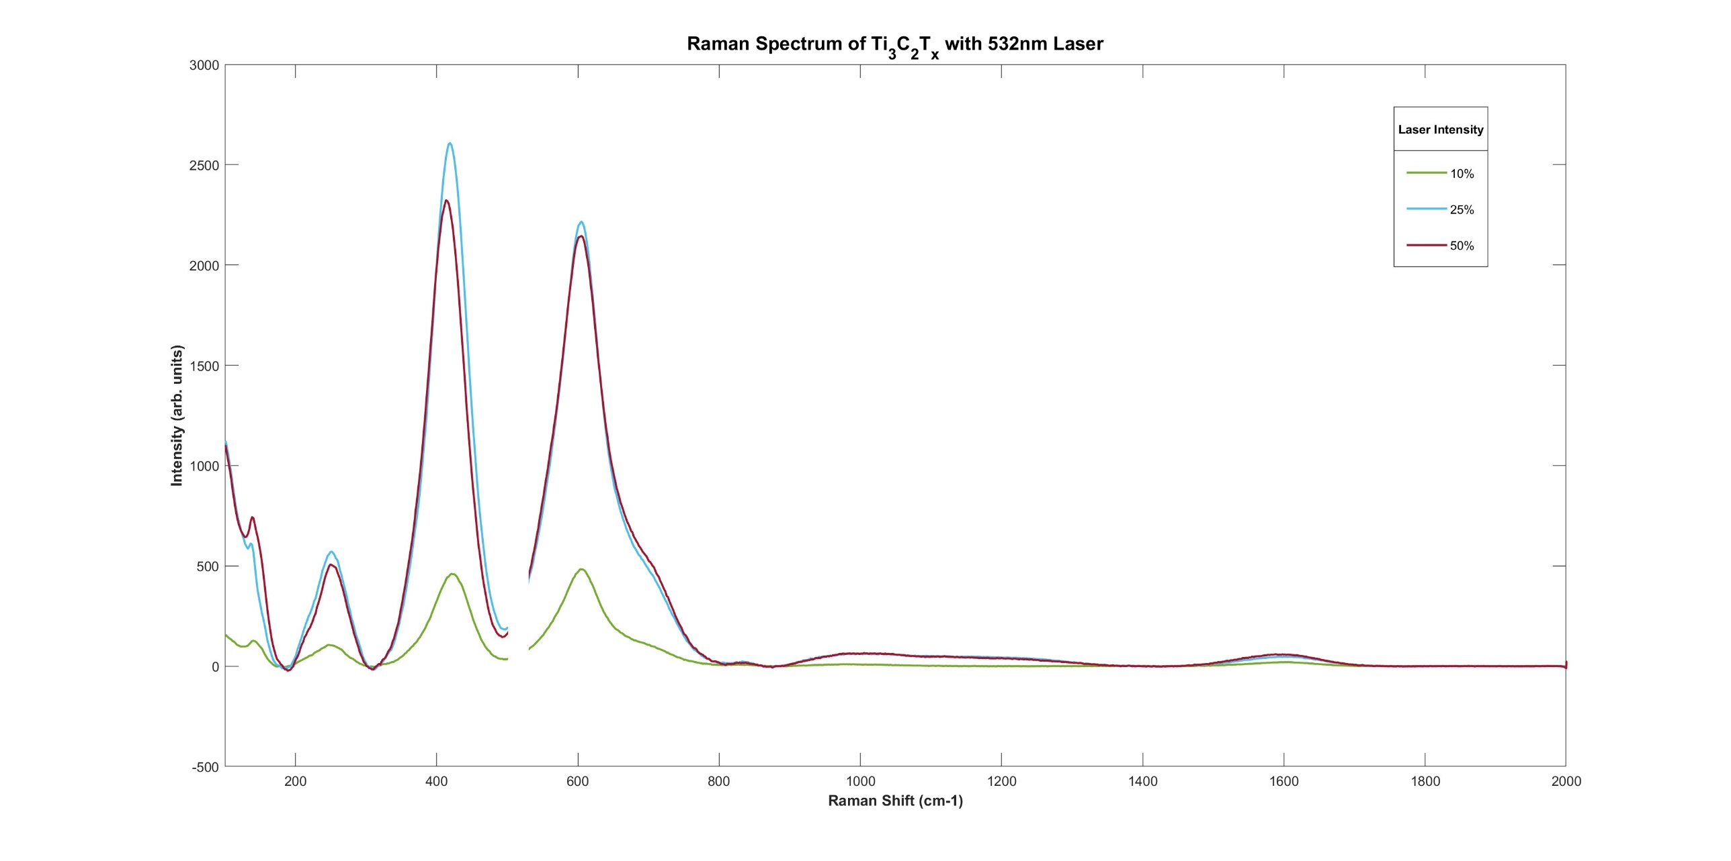
Two dimensional MXene materials have been intensively explored in recent years after the first discovery of Ti₃C₂T_{X} MXene at Drexel University in 2011 ¹ . To the date, over 100 stoichiometric MXene compositions are reported ² which drew a lot of attention among the researchers in material science and technology³. High electronic conductivity ^{4,5}, chemical stability ⁶⁻⁸, and hydrophilicity ^{9,10} of MXenes opened broad prospects for their applications in variety of industrial and technological areas including energy storage, optoelectronics, spintronics, catalysis, and sensing
Effect of Laser Wavelength on Raman Features of Ti₃C₂T_{x} MXene
¥Jianna Evans, ¥Destiny Darden, ¥ Dr. Narasimhan Sujatha, ±Dr. Daniel Autrey, ±Dr. Bhoj Gautam
¥,Wake Technical Community College, Raleigh, North Carolina, 27603
± Department of Chemistry, Physics, and Materials Science, Fayetteville State University, Fayetteville, North Carolina, 28306
Introduction
Methods and Materials
Conclusions or Implications
Two dimensional(2D) MXene materials have been intensively explored in recent years after the first discovery of Ti₃C₂T_{X} MXene at Drexel University in 2011.¹ To the date, over 100 stoichiometric MXene compositions are reported which drew a lot of attention among the researchers in materials science and technology.² High electronic conductivity, chemical stability and hydrophilicity of MXenes opened broad prospects for their applications in variety of industrial and technological areas including energy storage, optoelectronics, spintronics, catalysis, and sensing. ²
We observe the presence of a low angle peak 5.64⁰ in the XRD patterns which is attributed to the removal of the Al layer from Ti₃AlC₂ and the introduction of surface terminations on Ti₃C₂ layers.
We observed higher intensity when excited with 532 nm laser compared to the 785 nm laser for the same laser power and 1300 cm⁻¹ Raman mode is enhanced for 785 nm excitation.
Our results suggest that Raman features depend on excitation wavelength.
Ti₃AlC₂ MAX Phase was slowly added to a polyethylene bottle containing HF Acid and left to stir at for several hours. Then it was washed with deionized water and dried. Cartoon Figure on left was adapted from reference 2.
Results
Objectives
To study the impact laser wavelength on the Raman features of 2D Mxenes.
Abstract
Figure 2. Raman Spectrum of Ti₃C₂T_{X} with 785 nm laser
We employed X-Ray Diffraction and studied the effect of chemical etching Ti₃AlC_{2.}Using Raman Spectroscopy we investigated the effect of laser wavelength on Raman features of Ti₃C₂T_{X}. We observed the low angle X-ray peak at 5.64 degrees when Ti₃AlC₂ was etched with hydrofluoric (HF) acid and Raman signal is decreased at high intensity with 785 nm laser but not with 532 nm laser.
Figure 1. X-ray Diffraction patterns of Ti₃AlC₂ and Ti₃C₂T_{X}
Figure 3. Raman Spectrum of Ti₃C₂T_{X} with 532 nm laser
Acknowledgments
This work is supported by the National Science Foundation (NSF) PD 21‐7980 Advancing Innovation and Impact in Undergraduate STEM Education at Two‐year Institutions of Higher Education grant program, DUE‐2133600, NSF RIA HRD 1900998 and NSF RIA HRD 1800795.
Contact
References:
1. Naguib et al. Adv Mater 2011, 23, 4248-4253.
2. Fu et al. Chem. Rev. 2019, 119, 11980−12031
Jianna Evans
Wake Technical Community College
Email: jbevans@my.waketech.edu

